Slide 1
CUPE Local 5047
Halifax Regional School Board
Support Staff
October 27, 2017

Slide 2
Who We Are
Educational Program Assistants
Community Outreach Workers
African Nova Scotian Support Workers
Mi’kmaq Aboriginal Support Workers
Library Support Specialists
Early Childhood Educators – Leads and Supports

Slide 3
Your Local Executive
President – Chris Melanson
Vice President – George Lloy
Recording Secretary – Amy Parlee
Secretary Treasurer – Linda Dunn
Chief Shop Steward – Donna McCarthy
Sergeant at Arms – Michelle Stride

Slide 4
The Purpose of Your Local
Local 5047 of the Canadian Union of Public Employees was formed to:
  Improve the social and economic well-being of all of its members
  Promote equality for all members and to oppose all types of harassment and discrimination
  Promote the efficiency of public services
  Express its belief in the unity of organized labour
  The Local also provides an effective, positive buffer between employees and the employer, helping to navigate issues from everyday workload to disciplinary scenarios

Slide 5
THE STRUCTURE OF YOUR LOCAL
The membership meets 7 times per year, in the months of October, November, January, February, April, May and June - usually on the second Tuesday of the month.
The executive of your Local are elected during the April General Membership Meeting.
    The President, Recording Secretary and Sergeant-at-Arms are elected in the odd years.
    The Vice-President, Secretary-Treasurer and Chief Shop Steward elected in the even years.

Slide 6
Your Local has standing committees, elected to better serve our members:
    Grievance
    Pension
    Membership Support
    Communication
    Education
    Labour Management
    Occupational Health and Safety

Slide 7
We also have elected committees, that dissolve after the work of the committee is completed:
    Bargaining
    Bylaw

Slide 8
The Structure of Your Local (continued)
Your Local has dedicated shop stewards to assist in the alleviation of issues and concerns with direction or contract language.
Your Local has a method of approving anything that affects its members, from the acceptance of a new collective agreement, to its by-laws, and processes that allow the functioning and running of everyday business.

Slide 9
What Supports Does Your Local Have
National Representative – Karen MacKenzie (temporary)
CUPE Legal Representative – Susan Coen
CUPE Research Representative – Carol Ferguson
CUPE National Occupational Health and Safety Representative – Jenna Brookfield
CUPE National Communications Representative – Colleen Reynolds

Slide 10
What Other Supports Does Your Local Have
651, 000 members nationwide
An affiliation to the CUPE Nova Scotia Division representing 19,000 members province-wide
A website that has all our resources listed. For example: EFAP, discounts, documents, presentations, and more.
            http://5047.cupe.ca

Slide 11
Where and How to Access Resources
Your collective agreement can be found on the HRSB website, your Local’s website, and at each worksite within the HRSB.
Your Classification’s Job Description can be found in Document Depot.
To access CUPE National’s resources, contact a shop steward or the executive of your local and they will send a request to our staff representative.

Slide 12
Getting to Know Your Collective Agreement
Your collective agreement is just that, an agreement between two parties: CUPE Local 5047 and the Halifax Regional School Board.
It’s important for every member to know where to find a copy of your agreement and to familiarize yourself with it.
It contains the guidelines that both the employer and your Local expects to be followed when looking at staffing, the need for reductions, explaining the differences between term and permanent employees, leaves of absences and wages, and vacation pay.

Slide 13
Key Articles – Article 5
Article 5: Employee Status Definitions
  This Article describes the main differences between Permanent and Term Employees, as well as defining what articles are available to them.
5.01 Permanent full-time Employee means an Employee who is a member of the bargaining unit and is regularly scheduled to work full-time hours in a permanent position.

Slide 14
Article 5 (continued)
5.02 Permanent part-time Employee means an Employee who is a member of the bargaining unit and is regularly scheduled to work less than full-time hours in a permanent position.
5.03 Full-time hours mean the normal regularly scheduled hours of work in accordance with Article (10) - Hours of Work.

Slide 15
Article 5 (continued)
A “Term position” means a position with a specific start and end date, the duration of which is known in advance to exceed ninety (90) calendar days in a school year. A permanent Employee who fills a term position shall be entitled to all the rights and benefits of this Collective Agreement. A “Term Employee” means an Employee (other than a permanent Employee) who is hired to work in a term position as defined in Article 5.04 (a).

Slide 16
Article 5 (continued)
Term Employees shall be members of the bargaining unit with restricted rights and benefits of this Collective Agreement as follows:
(i) sick leave,
(ii) bereavement leave,
(iii) leave for jury duty,
(iv) holidays,
(v) benefit plan, and
(vi) payment of wages and allowances
(vii) assessment days entitled to one assessment day off with pay provided the day falls within the employee’s term
(viii) an in service day, pursuant to 29.04-paid day at in-service provided the day falls within the employee’s term in accordance with the relevant Articles in this Collective Agreement.

Slide 17
Key Articles – Article 9
Article 9 – Staffing
This article outlines how positions for CUPE members are staffed and when.
For all classifications, year-end staffing commences during the second full week of June. The most important thing to familiarize yourself with is when you can apply for jobs in which rounds.
      Permanent employees – first, second and third rounds
      Term employees – from the second round on

Slide 18
Key Articles – Article 9
The Halifax Regional School Board always sends out a Staffing Bulletin prior to Year End Staffing beginning.
It is important you know your seniority number, and that you fill in all pertinent information on both the Questionnaire and Cover Letter associated with your Online Resume that is kept for you in MyHRSB.

Slide 19
Key Articles – Article 12
Article 12 – Layoff and Recall
This article outlines how positions are made redundant, and the timing of these situations, as well as the recall rights effected employees have.
For all classifications, it is important to understand the process that is followed for reductions.

Slide 20
Key Articles – Article 15, 16 and 17
Article 15 – Sick Leave
This article defines the amount of sick leave each member gets, and how to determine what the differences are between a Term and Permanent employee have, how to access it, and how it can be accrued.

Slide 21
Article 15, 16 and 17 (continued)
Article 16 – Leaves of Absences
This article outlines what applicable leaves of absences are covered under the collective agreement (political; court appearance; personal, both paid and unpaid; pregnancy and parental; family illness and compassionate care).
An important note: the employer requires leaves of absences to be in writing, whether through the form found on Document Depot or by letter.

Slide 22
Article 15, 16 and 17 (continued)
Article 17 – Bereavement Leave
17.01 - When a death occurs in the Employee's immediate family, the Employee shall be entitled to bereavement leave of five (5) working days with pay, with two (2) additional personal days with pay for travel if required.

Slide 23
Bereavement Leave (continued)
17.02 - For the purpose of this article, immediate family shall be defined as spouse (including common-law or same sex partner where the couple has lived together for at least one year), parents, brothers, sisters, children, grandparents, grandchildren, mother-in-law, father-in-law, daughter-in-law, son-in-law, brother-in-law, sister-in-law, step and foster parent, child or sibling of the Employee or anyone for whom the Employee is the legal guardian.

Slide 24
Wages and Breakdown
Your wages and vacation pay are broken down on Page 82 of your collective agreement.
If you have concern over your pay, or discrepancies, your are directed to speak with non-teaching payroll staff at the HRSB.

Slide 25
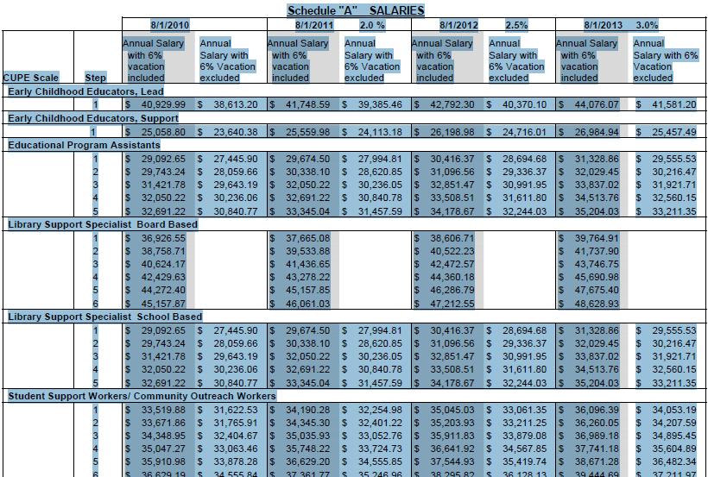
Wages and Breakdown (continued)

Slide 26
Addressing Concerns
When encountering Issues within your worksite, or with the understanding of a reduction, or a staffing scenario or direction given by the employer or your supervisor, it is important to follow the process that best enables all parties to investigate, address and potentially alleviate concerns.
We all must follow this so that all issues or concerns get addressed uniformly and effectively.

Slide 27
Addressing Concerns – Grievance Process
When you feel there is an issue or difference with the collective agreement or direction you must:
    Address this with your supervisor
    Get the answer to your concern in writing.
    Contact a shop steward, who in turn can address the concern and ask further questions.
    Provide the correspondence so all parties can be on the same page.
    Follow the timelines outlined in the Grievance Resolution process from Article 13.

Slide 28
Thank You!
Local 5047 is for the members, lead by the members and always needs your input and participation in order to function properly. We strive to be representative of all members, classifications, and the concerns they may have.
The Local wishes to share gains, recognize achievements and support struggles equally.
On behalf of the Executive of Local 5047, we wish to thank the Halifax Regional School Board for the ability to share this with you today, and to you all for attending and your continued support!

